Slide 1
How to Use Generative AI for Protecting Sensitive Data and Improve Operations
By: Shanysse Alexander and Brian Alvarez

Slide 2
Table of Contents
What is Generative AI?
Problem Statement
Impact
Purpose Of The Research
Case Study
Methods
Data Anonymization
Synthetic Data Generation
Differential Privacy for Data Protection
Text Data Redaction
Summary

Slide 3
What is Generative AI?
Generative Artificial Intelligence or GenAI is a set of algorithms capable of generating original content, spanning images, text conversations, and music on demand.
Aims to mimic human cognitive function.
Ex: ChatGPT, DALL-E, and Gemini

Slide 4
Problem Statement
How can we use Gen Ai to protect sensitive information and improve operations?
Gen AI models can be programmed to detect anomalies or dangers in a system.
Gen AI also is capable of masking or hiding sensitive data by replacing it with synthetic data so operations can run as normal.

Slide 5
Impact
Gen AI affects a wide-range of different levels of people in an organization.
Employees for example will have to adapt to working alongside AI systems while also monitoring the system themselves.
Customers and clients are also impacted because if an organization does not properly monitor their AI system, then that could lead to a leak of sensitive customer data.

Slide 6
Purpose Of The Research
It is important to continue the research of Gen AI because it is becoming the future of technology.
The only way to improve AI systems is to continue to test and modify them.

Slide 7
Case Study- The AI Generation Gap
In this study Gen Z students were compared to Generation X and Y teachers to see their use of Generative AI.
The findings show that Gen Z students are more optimistic about the benefits of Gen AI.
While Generation X and Y are more concerned about overreliance and the need for proper guidelines.

Slide 8
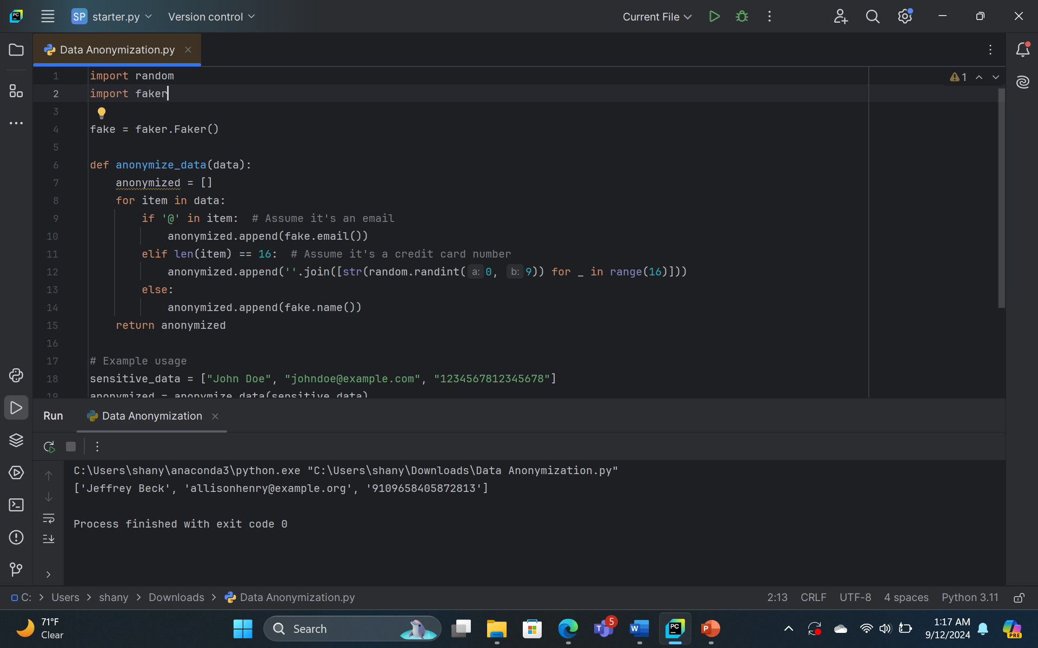
Data Anonymization

Slide 9
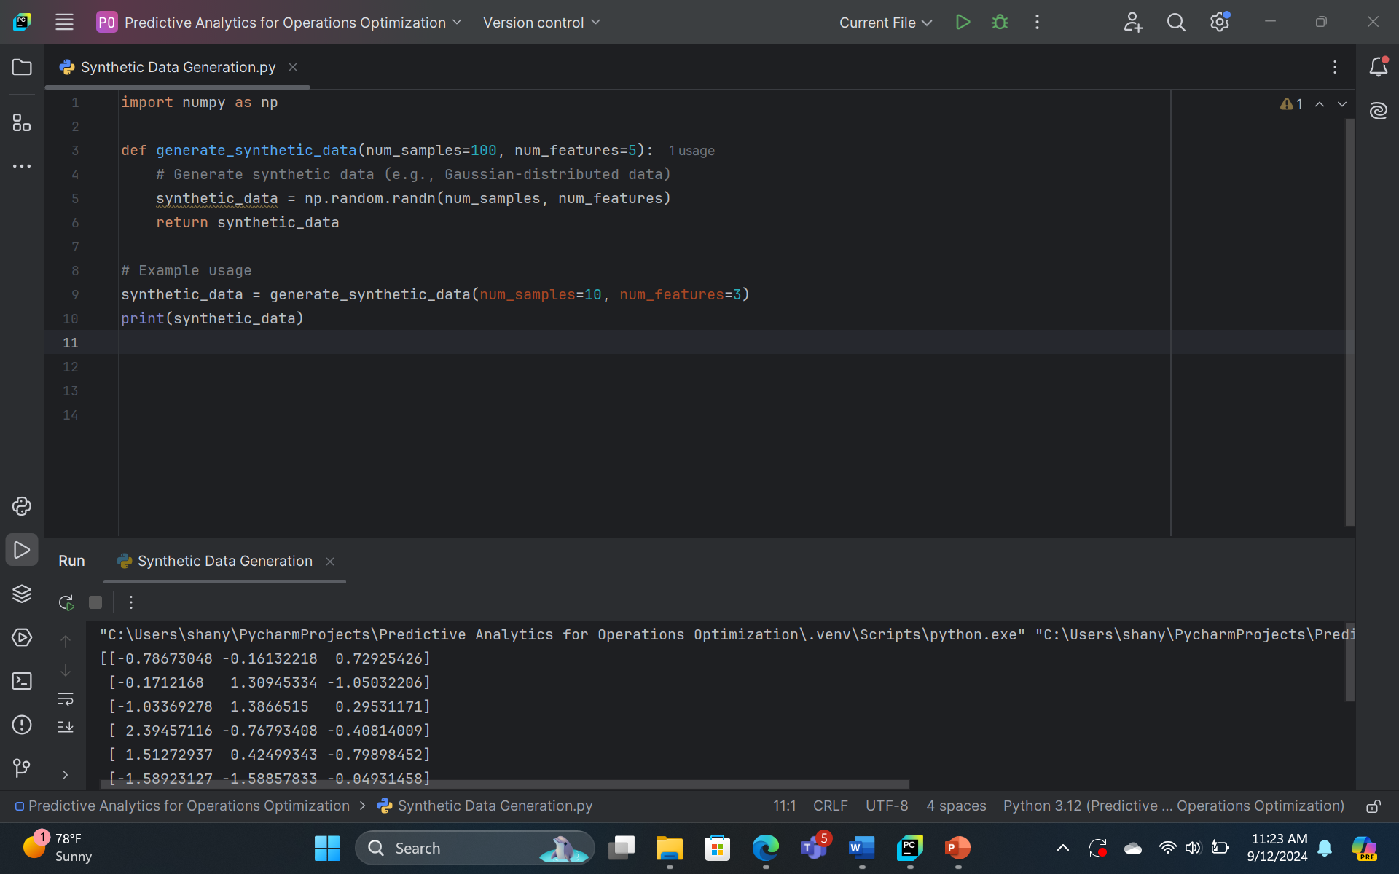
Synthetic Data Generation

Slide 10
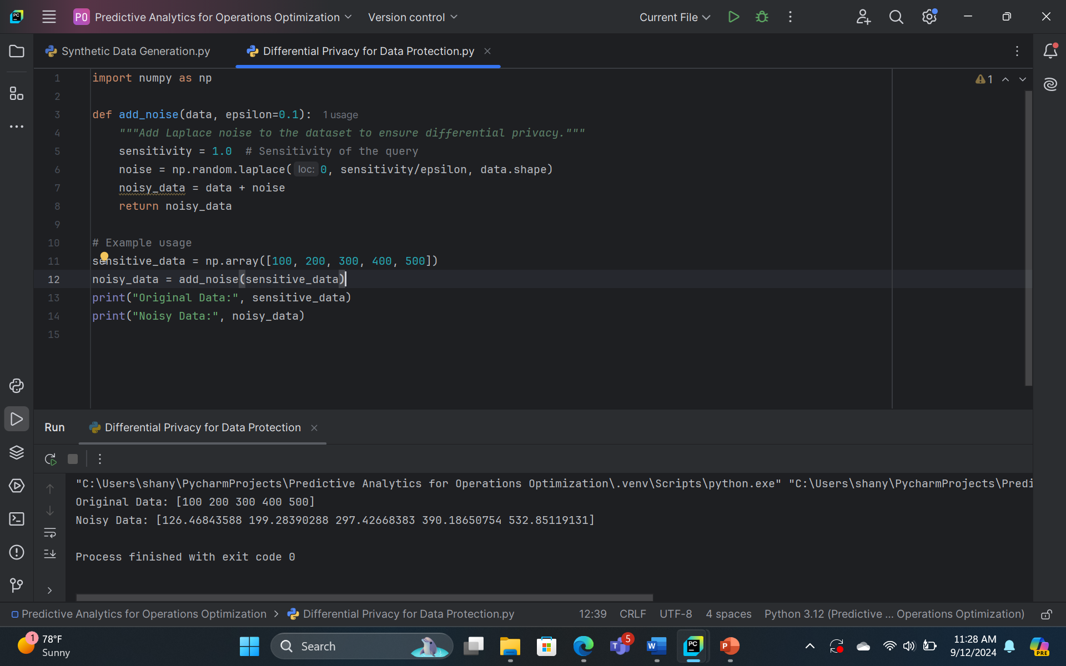
Differential Privacy for Data Protection

Slide 11
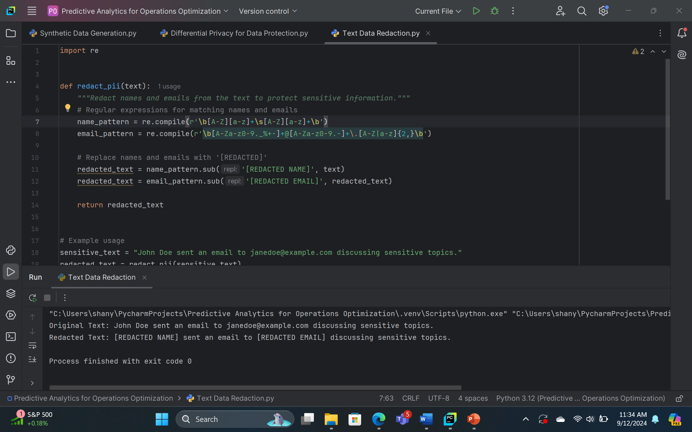
Text Data Redaction

Slide 12
Summary
In conclusion, Gen AI is important and growing at a fast rate. AI can benefit you by improving on your code, and provide you online resources. AI is being included in more technology to improve automation. Remain up to date and continue to further your knowledge on AI.

Slide 13
References

